Slide 1

The Fellowship of the Star Schema
Transforming OLTP Data for Power BI
Kristyna Ferris
Please grab some swag!
Fun Fact: this font is dyslexic friendly! Ask me how to use it for free after the session.
Notes:
Top 10 Dyslexia-Friendly Fonts for 2026 | TypeSmith | TypeSmith
Download the font from Atkinson Hyperlegible - Google Fonts
Extract the files
Go to computer settings > personalization > fonts and drop in the files
Navigate to Power Point Master Slide
Change the font to use Atkinson Hyperlegible for the headers and body
Done!
Atkinson Hyperlegible uses exaggerated asymmetry between mirrored letter pairs (b/d, p/q) and uniquely shaped terminals that prevent letter confusion.
Its design by the Braille Institute incorporates research on visual processing differences to minimize misrecognition at any size.

Slide 2

About Me ~ Kristyna Ferris
Microsoft MVP, Data Platform & Fabric
Solution Architect, P3 Adaptive
Lexington Data Tech Group co-organizer
DataOnWheels Author
Blog
https://dataonwheels.wordpress.com/
LinkedIn
https://www.linkedin.com/in/kristyna-ferris-dataonwheels/
Twitter & Bluesky
@data_dragoness

Slide 3

A Quiet Start in the Shire: Life in OLTP
“In a hole in the ground there lived a hobbit and a very efficient transaction system.”
Built for doing, not analyzing.
Every table has one job.
Dozens of normalized tables, optimized for speed.
Powers the front line like order entry, banking, point of sale, etc.
Writes fast, reads hard making it terrible for reports.

Slide 4
Behind the ERP: Normalized OLTP Tables
ProductCategories
Sales
Customers
CategoryID PK
CategoryName
SalesID PK
SaleDate
ProductID FK
CustomerID FK
SalesRepID FK
TerritoryID FK
QuantitySold
UnitPrice
TotalAmount
CreatedAt
CustomerID PK
CustomerFirstName
CustomerLastName
CustomerHouse
ProductSubcategories
SubcategoryID PK
SubcategoryName
CategoryID FK
SalesReps
SalesRepID PK
SalesRepName
Products
ProductID PK
ProductName
SubcategoryID FK
UnitPrice
Territories
TerritoryID PK
TerritoryName
RegionID FK
Regions
Each table has one job. Answering “sales by region” means walking four joins.
RegionID PK
RegionName
Notes:
Illustrative: the normalized tables an ERP keeps behind the flat export on the next slide. Same columns as the sample data, split the way a transaction system stores them.

Slide 5
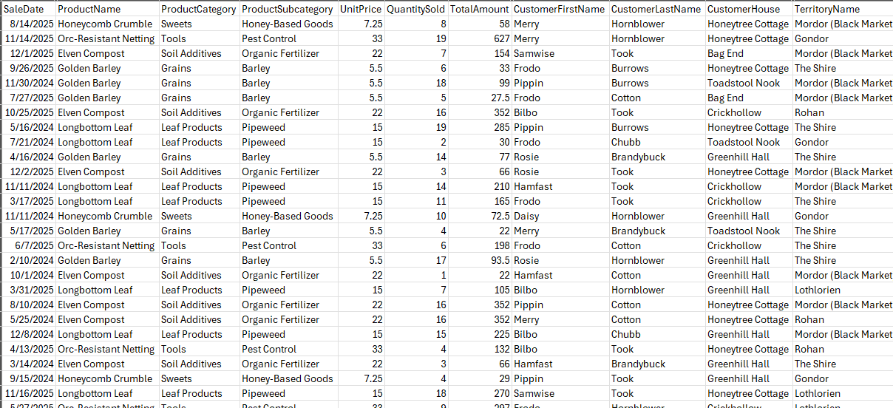
What the ERP Hands You: One Flat Export

Slide 6

Arriving in Gondor: OLAP Citadel of Insight
“The beacons are lit! The analysts call for data!”
Built for analyzing, not doing.
Fewer, wider, organized tables.
Designed for query speed across millions of rows.
Serves analysts, executives, and Power BI.
Data refreshed hourly or daily and prioritizing accuracy over immediacy.
Use cases: forecasting, sales analysis, executive reporting

Slide 7
Sample OLAP Star Schema
Date
Sales (fact)
Customer
Date Key PK
Date
Month
Quarter
Year
Sales ID
Date Key FK
Product Key FK
Customer Key FK
Territory Key FK
Sales Rep Key FK
Quantity Sold
Unit Price
Total Amount
Customer Key PK
Customer ID
Customer Name
House
Product
Territory
Product Key PK
Product ID
Product Name
Category
Subcategory
Territory Key PK
Territory Name
Region
Sales Rep
Sales Rep Key PK
Sales Rep ID
Sales Rep Name
Every relationship: one dimension row to many fact rows.
Notes:
Built from the demo data. Every dimension relates one-to-many to the fact. Product flattens category and subcategory, Territory flattens region.

Slide 8
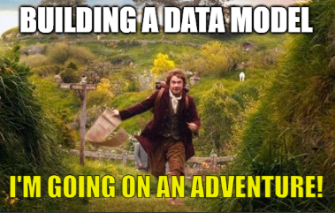
Journey to OLAP: Following the Star Schema
“One fact table to rule them all, and in the darkness, dimensions bind them.”
A proven design pattern for analytics.
Central fact table holds the numbers: sales, revenue, inventory.
Surrounding dimension tables give context: who, what, when, where.
Purpose-built for Power BI's VertiPaq engine with fewer tables, faster queries.
Unlocks slicers, hierarchies, and time intelligence out of the box.

Slide 9
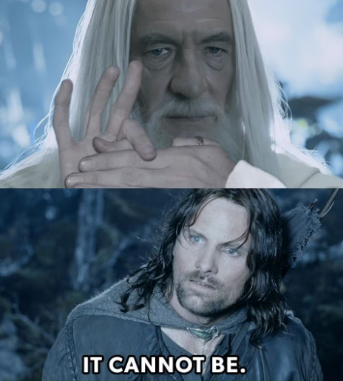
Demo Time!

Slide 10

The Council of Stakeholders: Defining the Quest
“You cannot pass... until you've answered these questions.”
Before a single table is touched, the council must convene.
Notes:
Pull out the bus matrix!

Slide 11
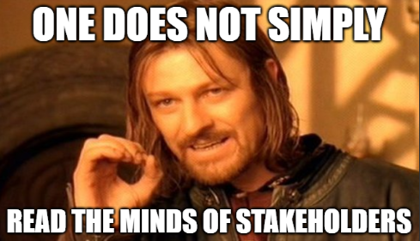
The Council of Stakeholders: Defining the Quest
What decisions will this data drive?
What are the "make more money" metrics that matter most?
What grain and scope does the data need?
Who uses this report -- and how do they slice it?
What dimensions give context to the metrics?
Where does the data live today?
Are there data quality landmines waiting to explode?
How often do these questions need answering?
Notes:
Bus matrix is coming up.

Slide 12
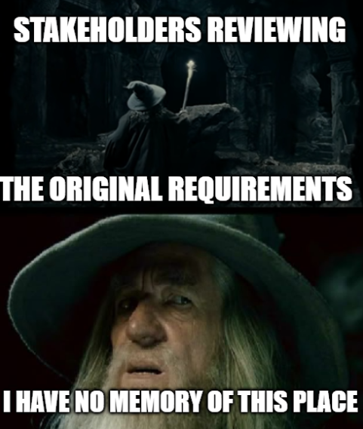
Pro Tip: Hold the Council Accountable
“A wizard is never late, but a stakeholder will absolutely forget what they asked for.”
Write the answers down and email them to stakeholders.
Creates a paper trail when scope creep shows up uninvited.
Even better: put the answers on a hidden page in the report itself.
The purpose of the report travels with the report.
Notes:
Bus matrix is next.

Slide 13
Mapping the Star Schema: Bus Matrix
Focus on measurable, event-based processes.
May result in the need for multiple reports and highlight missing data.
Dimensions → Business Process / Facts ↓ | Date | Product | Customer | Territory | Store
Sales
Inventory
Returns
Notes:
Benefits:
Clarifies Scope: Stakeholders see what data is needed and where it overlaps.
Encourages Reuse: Promotes conformed dimensions—single definitions reused across processes.
Supports Iteration: You can build out your data warehouse in increments.
Bridges Tech & Business: Translates messy system tables into understandable business concepts.
Facilitates Power BI Modeling: Leads to semantic models that support consistent slicing/filtering.
Don’t be afraid to include data that doesn’t exist for now.

Slide 14
Declaring the Grain: What Is One Row?
Grain is a map's scale. Zoom out too far and you lose Bag End. Zoom in too far and it won't fit in your pack.
Too coarse
Just right
Too fine
One row = monthly sales per region
One row = one product on one sale
One row = every item scanned
Month
Region
Amount
Sales ID
Product
Amount
Sales ID
Scan
Product
Jan
The Shire
$48,210
101
Longbottom Leaf
$30
101
1
Longbottom Leaf
Jan
Gondor
$31,906
102
Golden Barley
$20
101
2
Longbottom Leaf
Can't answer which product or which customer.
A map of all Middle-earth.
Rolls up to any month, region, product, or customer.
A map of the Shire.
Millions of extra rows, and no question needs them.
A map of every pebble in Hobbiton.
Go as fine as your questions need, and keep one grain per fact table.
Notes:
Grain is Kimball's second step, right after picking the business process from the bus matrix.
Analogy: grain is a map's scale. All of Middle-earth is too coarse to find Bag End; every pebble in Hobbiton is too heavy to carry. The Shire is the scale for this journey.
Too coarse: monthly totals by region. Looks tidy and small, but the first time someone asks 'which product?' you have to rebuild.
Just right: one product on one sale, which is the grain of the demo data. Each Sales ID appears once. Rolls up to anything the stakeholders asked for.
Too fine: one row per item scanned, so the same Sales ID repeats for every scan. Bigger model, slower refresh, and no question on the bus matrix needs it.
Rule of thumb: you can always roll up in DAX, but you can't drill below your grain. Go as fine as the questions need, not finer.
Keep one grain per fact table. Mixing grains (order totals on line-item rows) double counts.
Alternate analogy if the room likes hobbits: tracking food per day misses second breakfast; tracking every bite is madness; per meal is just right.

Slide 15

Guidance from the White Council: Best Practices
Tables
Integer key on every dimension, even if you have to make one.
One row per thing. No duplicate customers, products, or dates.
Don't import what you don't need. It's dead weight.
Columns
Each column lives in one place. Customer Name lives in Customer.
Specific, friendly names: “Customer Name,” not “Name” or “cust_nm.”
Relationships and shaping
Dimension to fact, one-to-many. Never fact to fact.
Roche's Maxim: transform as far upstream as possible, as far downstream as necessary.
Heavy lifting in SQL or ETL. DAX is for reporting logic.
“All we have to decide is what to do with the columns we are given.”
Notes:
Merged from three slides. Full talking points:
Create an integer key for dimensions. If one doesn't exist, make one.
Each column lives in exactly one place. Customer Name belongs in the Customer dimension.
Names must be specific. "Name" in both Product and Customer dimensions helps no one; call it what it is.
Use friendly column names. Spaces are fine in Power BI. "Customer Name" beats "cust_nm" every time.
Don't import what you don't need. Every unused column is dead weight on the journey.
One row per thing. Each dimension row represents exactly one customer, product, or date. No doubles.
Relationships run one way: dimension to fact. One-to-many, every time. Fact-to-fact relationships are the dark path through Mirkwood of poor performance. Do not go there.
Roche's Maxim: transform as far upstream as possible, as far downstream as necessary.
Do the heavy lifting in SQL or your ETL. DAX is for reporting logic, not data shaping.
Bonus quotes: “Even the smallest column can change the course of the future.” “Speak, friend, and enter. Name your columns like a friend would.”

Slide 16

Demo Time!

Slide 17
There and Back Again: Key Takeaways
01
Ask before you build
Convene the council, map the bus matrix, and write the answers down.
02
Declare the grain, then build the star
One fact table, dimensions around it, one-to-many every time.
03
Transform upstream
Power BI should receive a star, not build one. Save DAX for reporting logic.
Notes:
Three things to remember. Then hand off to resources on the next slide.

Slide 18
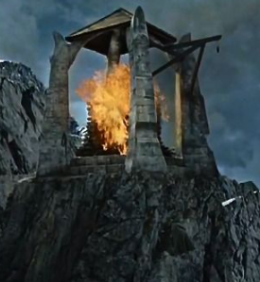
Light the Beacons!
Trusted Allies
Guy in a Cube
Kimball Group
Story BI training (hands-on course)
Pragmatic Works
Microsoft Learn: star schema guidance
Local user groups
Stalk the speaker list at conferences, they usually have other resources.
Additional Topics to Explore
Slowly changing dimension type 2
Measures versus columns
VertiPaq engine optimization
Cardinality
Creating a date table
Notes:
Article & Design Tips at Kimball Group https://www.kimballgroup.com/category/articles-design-tips/ for free articles covering 20 years.
Dimensional Modeling in Fabric Warehouse (Microsoft Learn) https://learn.microsoft.com/en-us/fabric/data-warehouse/dimensional-modeling-overview
Why Power BI Loves a Star Schema: https://www.youtube.com/watch?v=vZndrBBPiQc
https://learn.microsoft.com/en-us/power-bi/guidance/star-schema

Slide 19

Don’t forget to connect, thanks for listening!
https://dataonwheels.wordpress.com/
kristyna@dataonwheels.com
@data_dragoness
GitHub
LinkedIn

